Slide 1
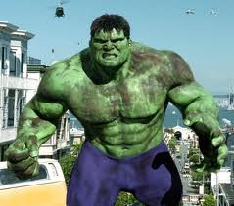
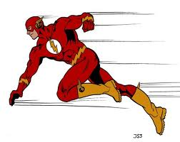
Warm Up- Tuesday September 4, 2012
List as many differences
as you can between these
two superheros.

Slide 2
There are two main locations in an atom.
Nucleus – contains the protons and neutrons.
Electron Cloud – Contains electrons.

Slide 3
Nucleus
The nucleus of an atom contains almost all of the mass of the atom. Therefore , the mass # is the sum of the protons + the neutrons.

Slide 4
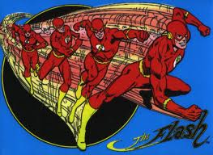

Slide 6
Electron Clouds
Electrons travel around the nucleus in a region called the electron cloud.
It is impossible to determine the exact location of an electron within the cloud at any particular moment.

