Slide 1
Warm Up- Tuesday September 18, 2012
Do the elements that appear on the periodic table exist anywhere other than earth?

Slide 2
Periodic Properties
of the Periodic Table

Slide 3
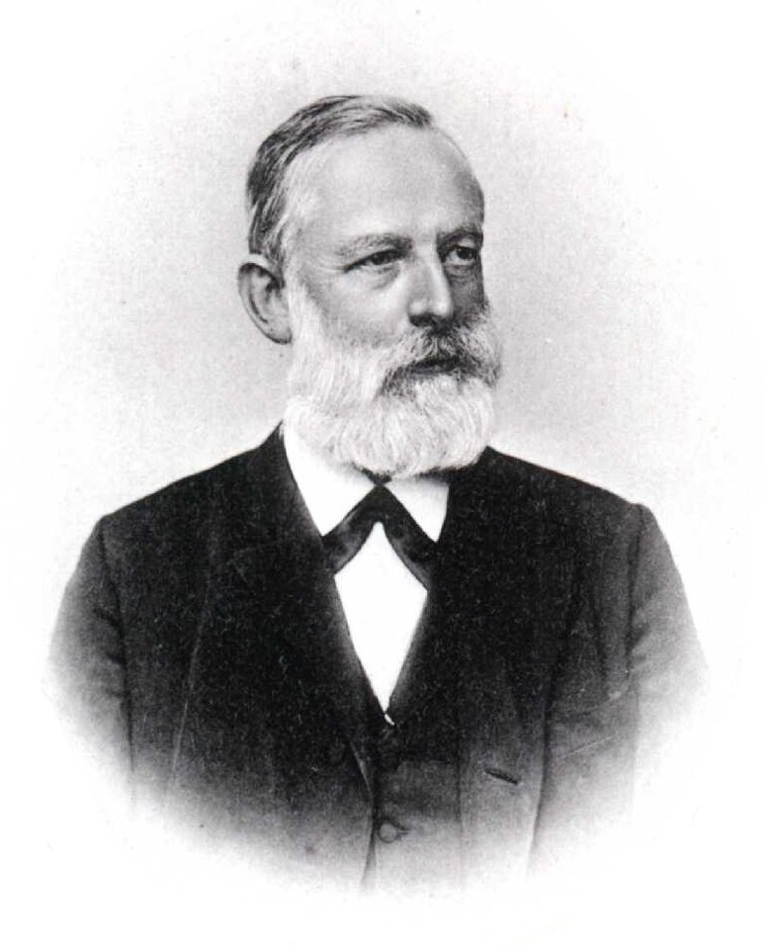
Organizing the Elements
In the late 1800s Dmitri Mendeleev, a Russian chemist, first organized the elements by increasing atomic masses
He even predicted the existence of elements that were not even discovered yet!!

Slide 4
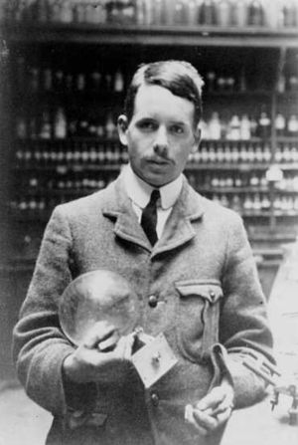
Organizing the Elements
In 1913 Henry Mosely, a young English scientist, rearranged the periodic table by increasing atomic number

Slide 5
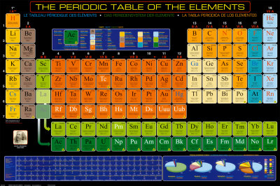
Organizing the Elements
Horizontal rows on the periodic table are called Periods.
Elements in these rows DO NOT have properties that are similar to each other.

Slide 6
Organizing the Elements
Vertical columns on the table are called Groups or Families.
Elements in these columns DO have properties that are similar to each other.

Slide 7
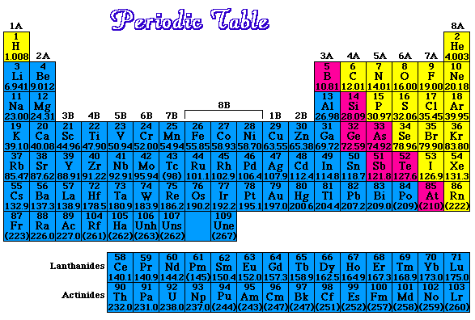
Regions on the Periodic Table

Slide 8
Periodic Properties
Elements are More Reactive

Slide 9
Periodic Properties
Reactivity
LESS
LESS

Slide 10
Reflection
Explain why the periodic table is better organized by increasing atomic number instead of increasing atomic mass as Dmitri Mendeleev first had it.

