Slide 1
Pressure and Fronts

Slide 2
Front
A front is defined as the transition zone between two air masses of different density. Fronts extend not only in the horizontal direction, but in the vertical as well. Therefore, when referring to the frontal surface (or frontal zone), we referring to both the horizontal and vertical components of the front.

Slide 3
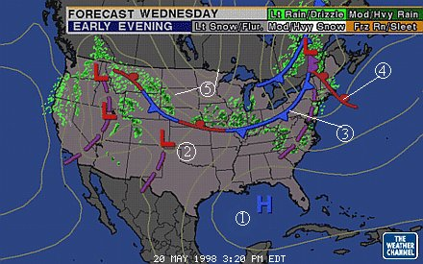
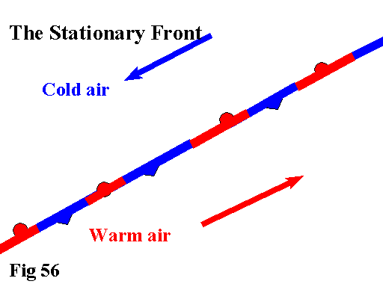
Stationary Front
A front that is not moving

Slide 4
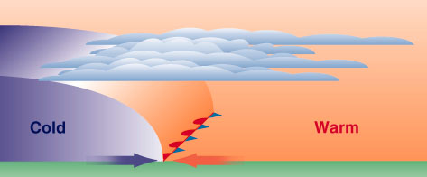
Stationary Front

Slide 5
Draw on your map any staitonary front you see

Slide 6
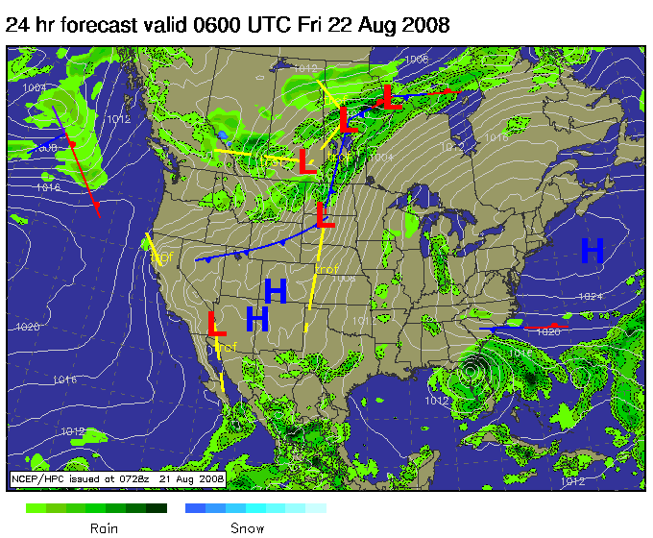
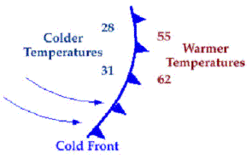
Cold Front
Leading edge of colder air that is replacing warmer air.

Slide 7
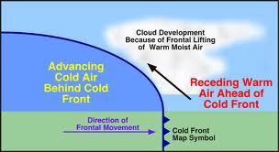
Cold Front

Slide 8
Draw on your map any cold front you see

Slide 9
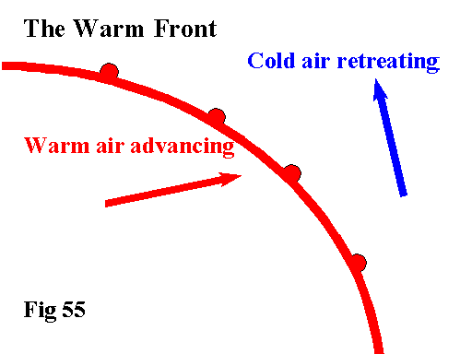
Warm Front
Leading edge of warmer air that is replacing cooler air.

Slide 10
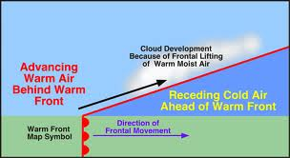
Warm Front

Slide 11
Draw on your map any warm front you see

Slide 12
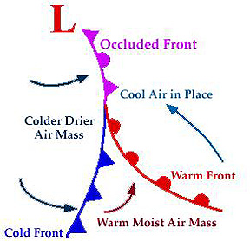
Occluded Front
When a cold front catches up to a warm front

Slide 13
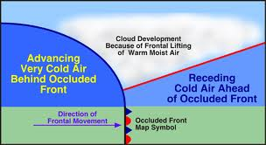
Occluded front

Slide 14
Draw on your map any occluded front you see

Slide 15
High pressure
Cool weather brings high-pressure systems:
Cooler air contracts, which means air molecules become smaller and take up less
space (so more of them can be packed into the atmosphere). High-pressure
systems usually bring sunny days.

Slide 16
Draw on your map any High pressure you see

Slide 17
Low Pressure
Warm weather brings low-pressure systems:
Warm air expands so there are fewer air molecules in the atmosphere. Lowpressure
systems usually bring cloudy and rainy days.

Slide 18
Draw on your map any Low pressure you see

Slide 19
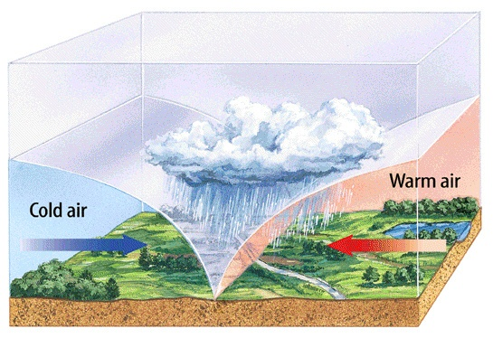
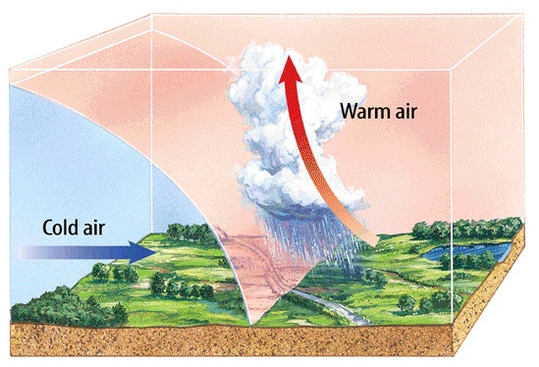
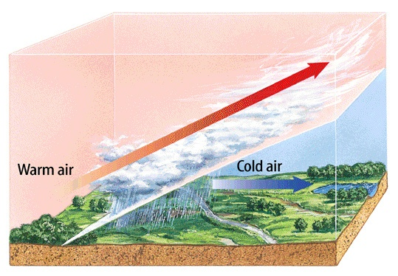
STAAR Practice: Weather 3
What kind of front is shown in the diagram to the right? (a) cold (b) warm (c) stationary
What kind of front is shown in the diagram to the right? (a) cold (b) warm (c) stationary
What kind of front is shown in the diagram to the right? (a) cold (b) warm (c) stationary

