Slide 1
Warm Up
What can you infer about these three objects?

Slide 2
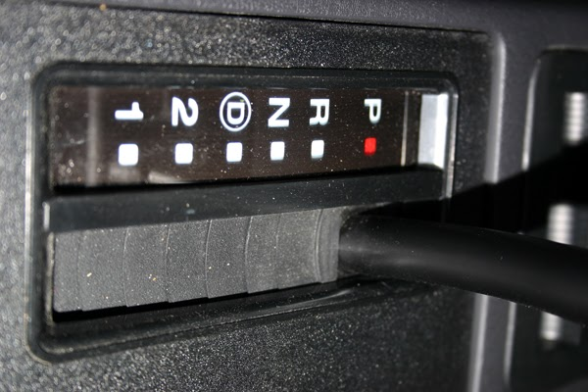

Slide 3
What can you infer about charges?
Proton
Neutron
Electron

Slide 4
Atoms
Atoms are made of three main parts:
Protons: have positive charge(+) and are located in the nucleus.
-Neutrons: have No charge(0) and are located in the nucleus.
- Electrons: have a negative charge(-) and are located outside the nucleus.

Slide 5
In any atom there are three things that are equal:
Atomic #, protons, and electrons.
To help remember this, think of the word APE.
Atomic #
Protons
Electrons

Slide 6
There are two main locations in an atom.
Nucleus – contains the protons and neutrons.
Electron Cloud – Contains electrons.

Slide 7
Nucleus
The nucleus of an atom contains almost all of the mass of the atom. Therefore , the mass # is the sum of the protons + the neutrons.
Protons
+ Neutrons
=Atomic mass

Slide 8
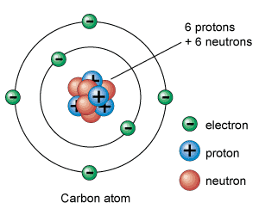
Bohr’s model

Slide 9
1
electrons
with
1 proton

Slide 10
1888
electrons
1 proton
=

Slide 11
HELIUM ATOM
proton
N
+
-
+
-
N
neutron
electron
What do these particles consist of?

Slide 12
STAAR QUESTION
According to the modern model of the atom,
A moving electrons form an electron cloud.
B electrons and protons circle neutrons.
C neutrons have a positive charge.
D the number of protons for a given element
varies

Slide 13
STAAR
An atom that has 5 protons, 6 neutrons, and 5 electrons has a mass number of
F 5.
G 11.
H 10.
J 16.

Slide 14
Reflection
Describe the structure of the atom.

